Slide 1
Project-Based Learning!
Dellie Wright and Dylan Kneidel
Notes:
dk8

Slide 2
What is PBL?
PBL - Project Based Learning
Learn through coding projects!
Notes:
Project Based Learning describes learning through hands-on work. Developing projects and learning by working working on those projects.
Example project: to do list app

Slide 3
Why learn through projects?
Notes:
dk8

Slide 4
Why PBL
Actual experience in a topic you’re interested in!
Rare opportunity to work on a project you completely define!
Learn more about the engineering/design process
Become a better programmer!
Notes:
Project Based Learning is used a lot by teachers! Students will go through an extended process of design, consideration, and implementation to solve a complex problem or challenge!
This empowers students to think critically about projects, developing deeper subject matter knowledge.
As you all know, we students rarely get to completely define what we code!
we mostly do labs - given coding problems
Project Based Learning provides an opportunity for you to completely define, design, and code a project!
By working on coding projects, you’ll naturally begin understanding the software development process:
Planning a project, designing and implementing it, testing it, and refactoring/improving it!
By working on projects where you code what you want, you’ll become a better programmer, expanding your knowledge beyond coursework!

Slide 5
but It’s More than that…
Projects are fun!
They’re a chance to work on something of YOUR choice!
How do they make you a better programmer?
Projects can introduce you to new technologies
They get you familiar with real development
They increase your chances of being hired!
Recruiters love hearing about personal projects
Notes:
But there’s a different reason I personally endorse project based learning.
I struggle to do things I don’t want to. I love doing things I’m interested in.
I’m a CS major bc i’m interested in code, and PBL gives me an opportunity to explore that interest.
Project Based Learning has done so much to improve my coding ability, my understanding of how code works and is built, and make me a better programmer
By working on projects, you naturally get out of your comfort zone!
Building a web app for the first time! you’re learning
Working with a back-end database for the first time! you’re learning
these real skills can be invaluable in your future, you never know when something you learned from a project will become super relevant.
I’ll talk more about this in the next slide, but working on projects increases your chances of being hired! They show initiative to learn and display a passion for what you’re doing!

Slide 6
How pbl can land you an internship
Notes:
Now, how can projects land you an internship? I’ll give an example:
At career fairs, talking about yourself is incredibly intimidating, especially for those earlier in their college career.
Projects can give you starting points in conversation, create strong connections, and show your capability as a developer to a company.
showing up with a project vs. without
At every career fair I’ve been to, I’ve talked about the projects I’ve worked on. And I swear you can see a recruiter’s eyes light up when you mention a project you’re working on that is relevant to their company.
Especially if you’re talking to a developer, they might have experience with an exact framework you used for a project, creating a connection and further driving conversation.

Slide 7
How can I get ideas for a project?

Slide 8



How Projects Start…
All software projects come from an idea!
What makes a good idea for a project?
Outside of Comfort Zone
Realistic
Some Familiarity
Relevance & Interest
Simple
They Don’t need to be:
Revolutionary Ideas
Overly Complex
Notes:
The first step in any good project is Ideation! - Generating an idea for your project.
A good project starts with a good idea. These ideas shouldn’t be overly complex, but should communicate the purpose of an application. For example:
facebook was an Idea to allow students to connect with eachother over the internet
Photoshop was an idea to create an effective photo editor.
Uber was an idea to allow anyone to be a taxi driver and make money while doing it.
These ideas are not overly complex, provide context for a coding project, and adequately describe each application.
One thing about all of these ideas, is that they’re revolutionary. The companies that brought these ideas to life have been able to profit immensely from these ideas because they’d never been done before.
Our project ideas do NOT need to be revolutionary. A good project could totally reinvent the wheel and still be a good project.
I say this because a good project, like a good question, is one where you learn something new! They don’t need to be Fortune 500 Ideas, just ideas that get you outside of your comfort zone and can get you coding!
Another aspect of a good project/idea is realism, you shouldn’t set a goal to code a project with Machine Learning if you don’t know how to code. A project should be challenging, but not impossible. If a project isn’t challenging, what was the point of doing it? But at the same time, it shouldn’t be impossible or too hard to the point it gets discouraging.
I like to have projects that have some familiarity, like in a familiar coding language, but introduce me to something new! Like using a web framework like Flask.

Slide 9
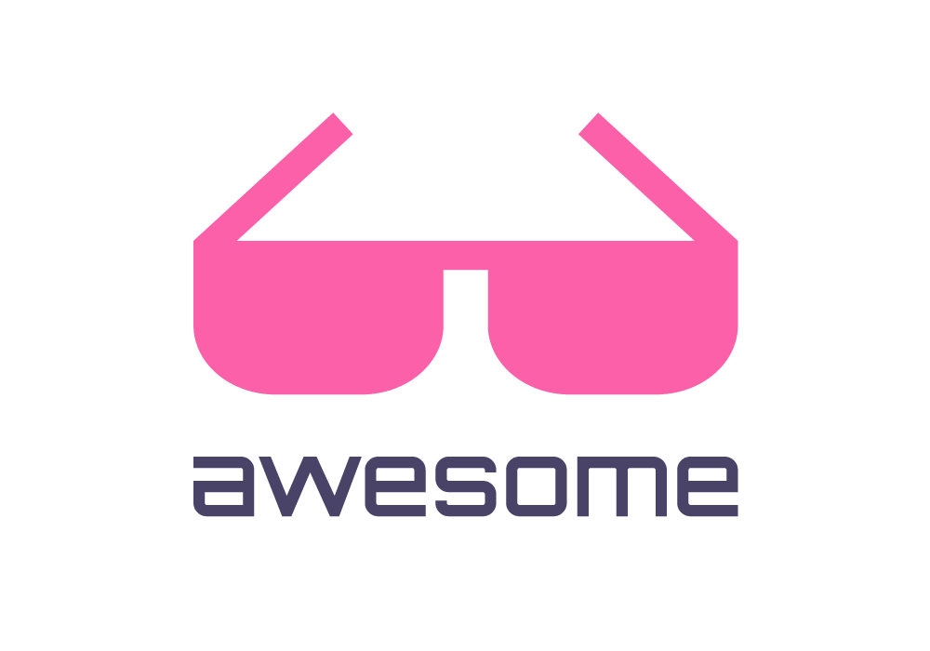
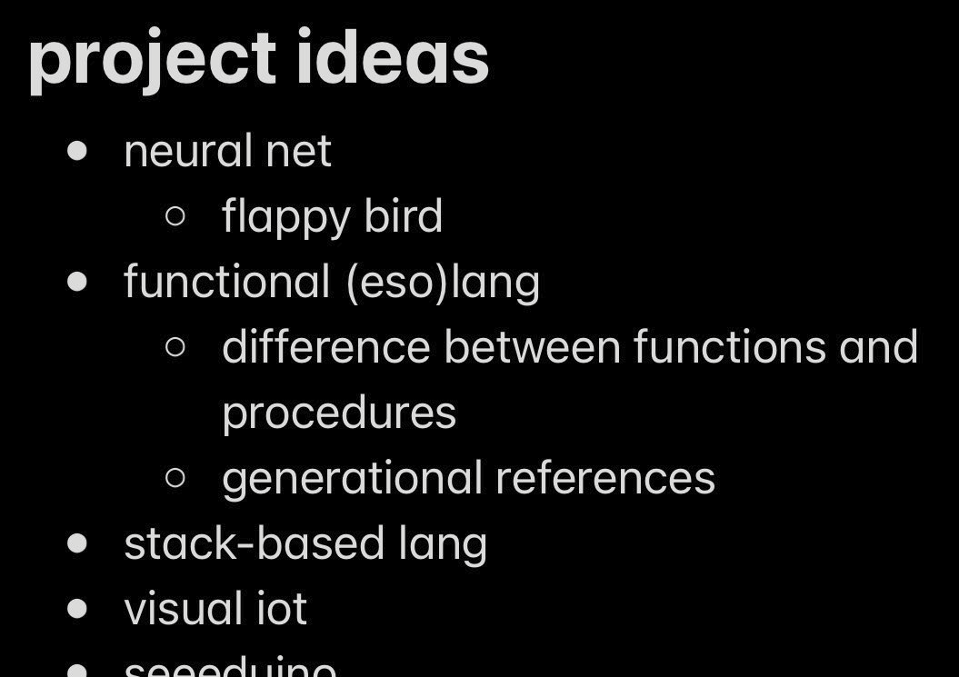
Project Hunting
What interests you?
Project Awesome/Awesome Lists
Ask an AI!
Keep a backburner…
Notes:
So, how do you find an idea for the project if you can’t think of one?
Firstly, think about what you’re interested in. Think Machine Learning is cool? There are plenty of tutorials to build your understanding, work through those tutorials and I bet you’ll come up with an idea as your understanding builds.
Another great resource for this is something called Project Awesome, they create curated lists of awesome things! They’re mostly CS ppl, so it is a lot of resources for things in that space. These can contain resources to learn more, project ideas, and many more. If you spend some time scrolling through you’ll know what I’m talking about.
go to awesome list website and pick random example with audience
Also ask an AI, they are great at idea generation.
And keeping a backburner can be helpful, jot down stuff as it comes to you, and look back at it to determine if there’s anything you want to build!

Slide 10

Cont’d
Think of…
Problems in your daily life
Desires of yours
Interests of yours
Anything can be a project!
Some good questions to drive brainstorming…
How many new things am I willing to pile onto this?
How long do I want to work on this?
Who is my target audience?
Notes:
More ways to come up with project ideas:
think of stuff you experience in your day-to-day life. One of my first coding projects was an application that added google reminders from text in my command-line. I wanted to do this because I spent so much time in my terminal, and wanted to be able to create reminders from the terminal!
These ideas are totally okay to reinvent the wheel. The app I made totally exists, but I learned so much by working on the project.
Anything you find can be a project! Hear about something interesting in 268 or a class, go implement it! This project could take 10 minutes, but you’ll likely learn something new and improve your coding skills by implementing it! Go code the mazewalker 268 students!
Some good questions:
How many new things - basically how far out of my comfort zone can I get?
How long - Set a deadline to keep yourself accountable.
Target audience - who is this for?

Slide 11
How do I plan my project?
Notes:
dk8

Slide 12
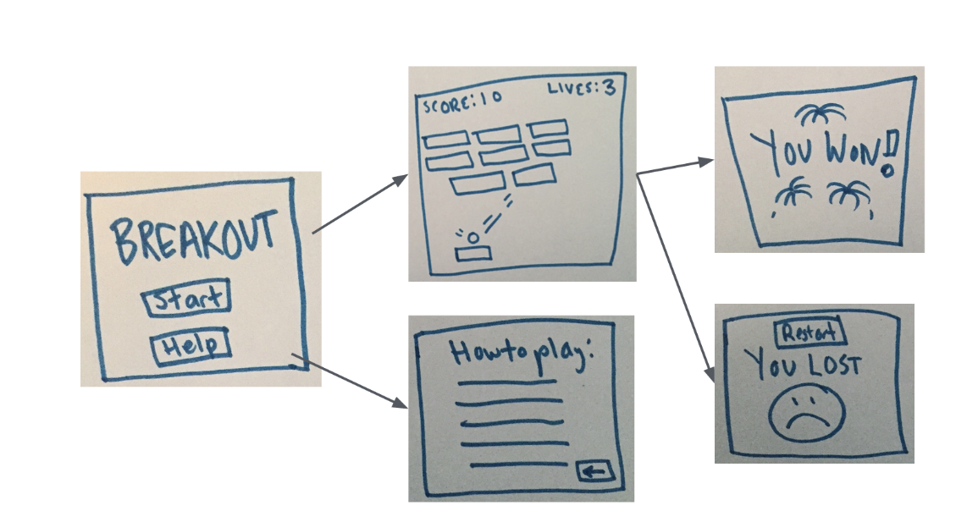
Breaking down a project
Identify Major Components
Consider Project Features - To Do App!
Must Haves vs. Nice to Haves
Consider Implementation
How does everything connect?
What libraries or frameworks will I need?
Create a todo/task list!
Notes:
Now that we have an idea for our project, how do we break it down and get started?
The first step, for me, in breaking down a project is the identification of major components.
For example, let’s say i’m building a to-do list app (this is a common example of how reinventing the wheel can teach you so much)
I need a database to hold and store todos
I need to be able to add/remove todos
I need a web-interface to access and communicate to this database
Wow! now we have something we can work towards implementing, now, does anyone have features that might be included in this to do app? Please shout out
Break these down into must haves vs. nice to haves
These are important, because as development continues, bugs, headaches, and much more are inevitable. By separating must-haves and nice-to-haves, we can adequately prioritize what features should be done first?
Now, for this example, could someone give me some examples of frameworks or technologies that might be needed for a project like this?
Flask
Sockets
database library
By having this list, we can look at what might be unfamiliar, find resources to understand new libraries or frameworks, and better understand how our project will work.
After understanding major components, features, and the implementation of your project, it might be a good idea to create a comprehensive to-do list. This will give you a concrete, chronological list of taks that will result in a finished project! You now can get coding!

Slide 13
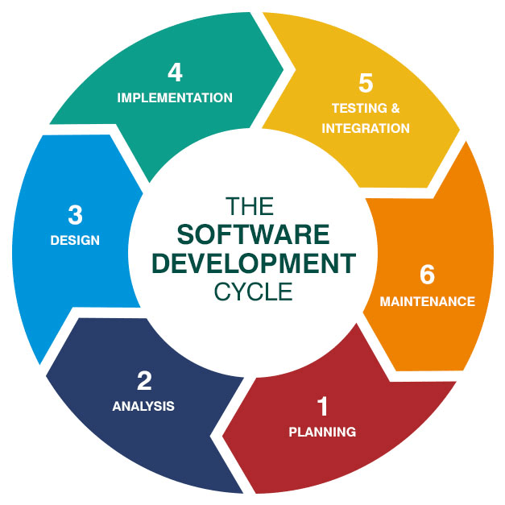
Project Design
Break the project down!
Notes:
You can also think of breaking down the project into separate phases, this can provide a different view, and different understanding of how your project works together and will be implemented.
Planning - this is the step we kinda just did! we’ve planned out what needs to connect and how we will build our app.
Analysis - this step involves looking over our plans and determining possible improvements to our plan. Can we use a different, more familiar framework? Am I sacrificing learning by doing so?
design - this is where you start coding
implementation - think of this as your first time running your code
Testing - finding the inevitable bug from a first time run
maintenance - fixing the first time run bug

Slide 14
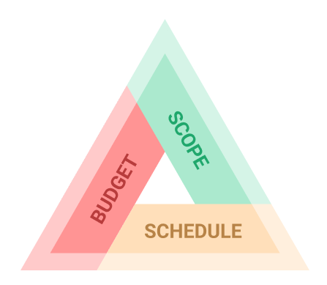
PM - THe Big 3
Scope
Define a clear scope for your project
Clear goals, tasks, and deliverables
Schedule
What are some realistic deadlines or goals?
Time Management - you’re a student!
Budget
Resource Allocation - time, money, hardware…
Open Source Software!
Notes:
Because we’re talking about projects and Project Management, I had to hit on the big 3 of project management. Scope, Schedule, and Budget. This might be a bit of a tangent, but this is an important aspect of managing any project, and you should all know of this PM Trio anyways.
The 3 most important things in any project are the following: Scope, Schedule, and Budget. If you sacrifice one, a project can fail. For example in the working world, if your project doesn’t meet the scope defined, it is a failure, if the project is completed late or is unfinished by the deadline, it is a failure, if the project exceeds the allocated budget, it is a failure.
We won’t hold your coding projects to the same standard though, Scope, Schedule, and Budget looks a bit different in a personal coding project.
In our context, we can think of scope as, what our project has to do! This contains the more specific requirements of our project, what it does, how it does it, and the purpose of our project. This defines clear goals, tasks, and deliverables for a project.
As students without a deadline for a project like this, schedule has a different definition than it might in Project Management. Think of some realistic deadlines for your project. IK sometimes when I don’t have a deadline on something it just won’t get done so this could also be a helpful accountability tool.
Since this software project likely wont have a concrete budget, we can think of a time budget for this projet - how mucht ime are you willing to spend per week on this? How much can you spend, accounting for classes, personal time, etc.
This is also a chance to plug using open source tools, as they are free!

Slide 15
Choosing project technology

Slide 16


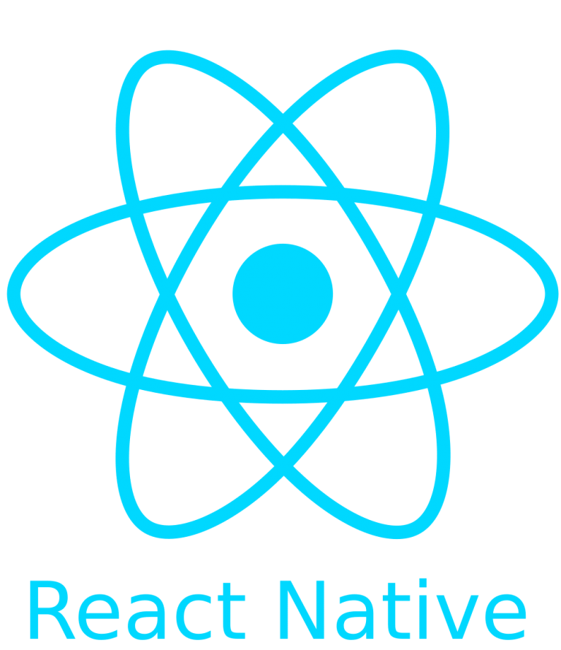


What is Project Technology?
The libraries, frameworks, and languages you will use to build your project.
Examples:
Python & Flask
LAMP
MERN
React Native
Flutter
Many more!
What is a dev Stack?
What is Documentation?
How to use Version Control Systems?
Notes:
So, you’ve heard me mention things like frameworks, coding languages, etc. as something you choose in a project. This is considered choosing project technology - the coding languages, libraries, and frameworks a project relies on. Some popular examples are:
LAMP - Linux, Apache, MySQL, PHP
MERN - MongoDB, Express, React JS, Node
These ”tech stacks” describe the set of technologies used to develop an application. These can include databases, front-end tools, back-end tools, APIs, and more.
Documentation describes how to use a specific piece of technology in a tech stack. For example, flask’s documentation describes how to use flask with python to build a web app!
Using version control systems is also incredibly important in a project. They allow you to keep track of your work, develop a portfolio of projects, and much more. We recommend using github repositories to store your projects.

Slide 17
choosing project technology
Familiarity
Can I write code with this?
If not, are resources readily available?
What does my project need?
What kind of app is my project?
What functionality does my project have?
Scalability?
Performance requirements?
Get out of your comfort zone! Try something new!
Notes:
Now, how do we actually choose projet tech?
As you might assume, familiarity is pretty important. You don’t want to choose C++ as the language for your project if you have no experience with C++!
Now, what happens when you inevitably run into something that is necessary for your project but you are unfamiliar with..
ex: need a database tool without any databases experience
Use resources! I’ll talk about this in the next slide.
Another thing to consider is what your project needs! Think back to the Breaking Down a Project slide, we did some of this work there. For example, if you’re building a project that requires speed and low-level control, python might not be the best answer!
Finally, when choosing project technology it is important to get out of your comfort zone! It’s how you learn!

Slide 18
Finding & using project resources
What is Documentation?
How do I read it?
Where can I find it?
Don’t be afraid of reading!
Getting-Started
Tutorials
/examples/
Resc:
Geeksforgeeks
ChatGPT
W3Schools
Notes:
d3 - example of documentation and getting started pages
Documentation - Documents created by the developer of an application or library explaining how the application works and how to use it.
remember: some of the libs we use have a sole developer!
You can find documentation for lots of things by searching “XXXX Documentation” or on readthedocs.io
One thing to note here, don’t be afraid of reading and looking things up when reading documentation. Sometimes it can be incredibly intimidating to be met with a webpage full of unfamiliar vocab in an unfamiliar territory. But you can understand it, I promise. Documentation contains all of the information you need to build an app, it’s just a matter of understanding it.
Now, let’s look at some documentation and talk about how to use it when starting a project.
Installation - important first step! How do i install the library to work with it?
Quickstart/Getting-started - usually has a barebones application using the framework/library that you cna edit to get started
Tutorials - More explanations and more complex features implemented by the library.
Examples - usually on a github repo, display functional examples of how smth works

Slide 19


Using Version Control
https://github.com/delster1/bugSmashers/tree/main/9-7-23_versionControl
Notes:
version control is also super

Slide 20
activity: Whose project is it anyway??
Project Idea: Roman Numeral -> Integer Conversion
Output:
XIV : 14
XXII : 22
LXIX : 69
LXXVX : 75
XLIII : 43
CMXCIX : 999
IIIIIIIIIX : 1
MCMLXXXIX : 1989
Notes:
Now for an activity! Let’s pretend you are building an application to process text data, but some information is stored in roman numerals. You need to process these into normal integers.
But, to make things interesting. We’re doing this activity in a “whose line is it anyway” kinda style. Where I’m going to call on one of you to write a line of code to solve this problem, then call on someone else for the next line…
By the end of this meeting, we’ll hopefully be able to process all of these strings to get an accurate result!

